Slide 1
CORPORATE SAFETY IMPROVEMENT PLAN
Plant & Equipment Register
Unit Workshop
2020

Slide 2
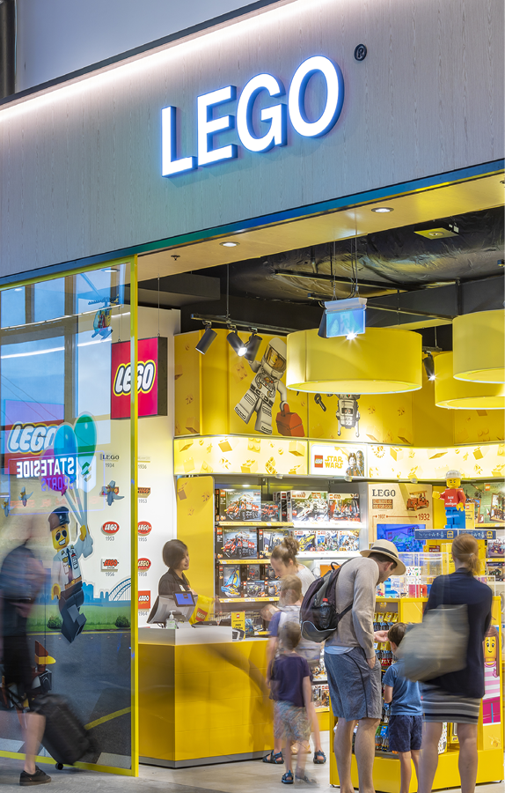
Agenda
Project Background
Project Executive Summary
Overview
Project Scope & Schedule
Accountability
P&E Register
Concepts
Implementation Process
Next Steps

Slide 3
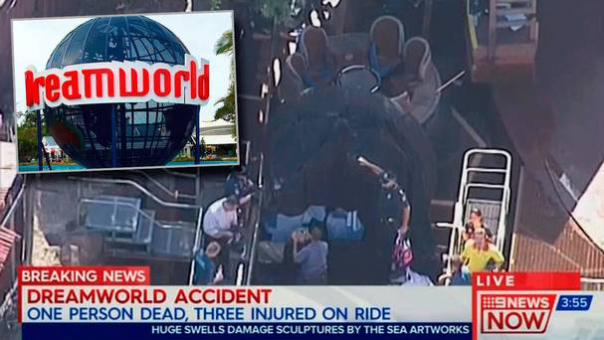
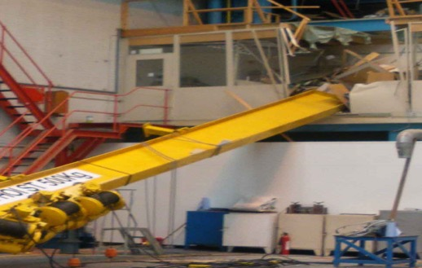
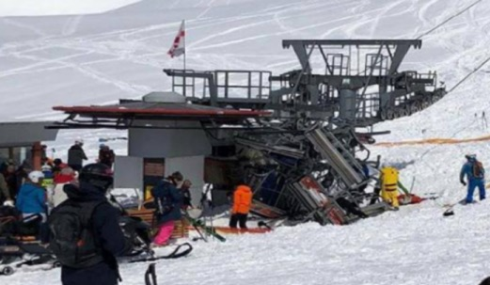

Project Background: Safety
Every year, thousands of workers who use plant and equipment suffer horrific injuries.
Over the past four years there have been more than 160,000 injuries in NSW workplaces alone, as a result of using plant incorrectly. More than 6000 workers were permanently disabled and 64 died.
Newcastle (UK) Sling Failure: Beam falls 14m, narrowly missing workers
Gudauri (Georgia) Ski Lift failure -11 Injured
Jingzhou (China) Escalator death could have been prevented

Slide 4
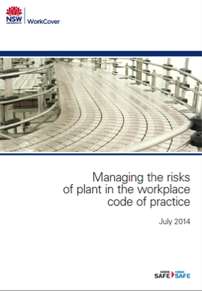




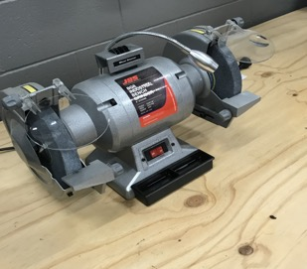
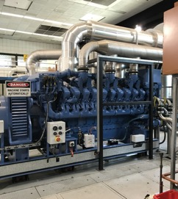
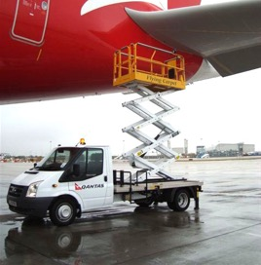
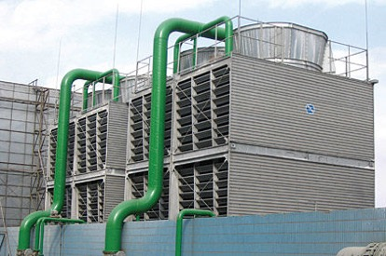
Project Background: Legislation
Sydney Airports Plant and Equipment register project aims to consolidate the full range of information required to streamline management and maintenance of plant and equipment in line with legislative requirements:
Chapter 5 of the WHS Regulations 2017 plant and structures:
Division 7 - General duties of a person conducting a business or undertaking involving the management or control of plant
Subdivision 1 - Management of risks to health and Safety (Clause 203)
Subdivision 2 - Additional control measures of general plant (Clause 204 – 213)
Subdivision 3 - Additional control measures for certain plant (Clause 214 – 226)
“A person with management or control of plant at a workplace must manage risks to health and safety associated with plant, in accordance with Part 3.1.”

Slide 5
02
Project Executive Summary
CSIP Improvement Objective #14 Summary
Implementing a P&E Register

Slide 6
Project Background: CSIP
CSIP improvement objective #14 – Plant and Equipment Procedure Action Plan
Develop a Plant and Equipment procedure that documents Sydney Airport practices for;
Decommissioning of plant and equipment
Ensure a plant and equipment register is maintained and updated and provides a single source of truth, details who is responsible, location, maintenance history and inspection history
Identify processes for smaller items of plant equipment e.g testing and tagging, and include corporate office equipment
Project Summary Timeline
June 2016
October 2016
December 2016
March 2017
May 2017
September 2017
February 2018
March 2018
CSIP items approved by Safety Steering Committee
Researched and documented current practices within the business, reviewed existing systems and registers.
Gap analysis undertaken, identifying multiple non-conformances and inconsistencies across departments
Began developing plant and equipment procedure.
Require an appropriate system in order to implement the procedure.
Project leader established and handover provided
Project endorsed and approved
Project Commencement
“The implementation of a functional Plant and Equipment register will allow Sydney Airport to track and register assets, as well as successfully commission plant & equipment and de-commission existing plant & equipment, following removal or end-of-life.”

Slide 7

Project Executive Summary
Implementing a P&E Register
unitiFM have been engaged to facilitate the Sydney Airport Plant and Equipment Register project. The project will involve the development and implementation of a Plant & Equipment Register that provides consistent, managed and transparent compliance information. The broad scope will involve:
Conducting a business process review
Enhancements to the current Asset Management system capabilities (AM Maximo)
Conducting data gathering, review and input, design and development of maintenance plans
Inspections and audit requirements aligned with the Sydney Airport Plant & Equipment Procedure
Development of reporting modules for departments
Facilitating the initial roll out of training packages
Ongoing hosting, licensing and system support
Planning and Design
Development and Configuration
Implementation
Phase 1
Phase 2

Slide 8
Phase 2: Implementation Schedule Breakdown
Aerobridges
Power Gen
AGL
Mech Works
HVAC
Building FM
BHS International & Domestic
Civil Assets
Cleaning
Operational Vehicles
Property (future project)
Fire
Unit Roll-Out Schedule
Based on Weighting of:
Complexity
Current Maximo Status
Organisational Readiness

Slide 9
Accountabilities
The below personnel have been identified as responsible persons with regards to the management of categorised plant and equipment at Sydney Airport.
# | Area or Department | Responsible Person | Status
1 | Aerobridges | Phil Massingham | Implemented
2 | Power Generation & LV Electrical | Con Karlis | Implemented
2 | HV Electrical | Guy Turner | Implemented
3 | AGL | Craig Bruckard | Implemented
4 | Mechanical Assets | Steve Farrelly | Implemented
5 | Fire | Andrew Barr | Implemented
6 | HVAC | Andrew Barr | Implemented
7 | Civil Assets | Jeremy Sham | Implemented
8 | Operational Vehicles | Daniel Boyd | To Be Finalised
9 | BHS T1 | Andrew Cox
9 | BHS T2 | Craig Friend
10 | Building FM | Jeff Smith
11 | Cleaning | Daniel Boyd

Slide 10
03
P& Register
Concepts
Implementation Process
Ongoing Management and Governance

Slide 11
Plant & Equipment Concepts
Plant & Equipment
Sydney Airport Assets
Plant & Equipment Register
What
Who
Owns
Maintains
Operates
P&E Category
Registrable Plant
High Risk Plant
Specialist Equipment
General Plant & Equipment
P&E Type
Fixed Plant
Mobile Plant
Powered Mobile Plant
Other Equipment
Other Special Requirements
Statutory Maintenance
Licensing to Operate
Verification of Competency
Asset Modified
Higher
Lower
Risk Profile
items of plant and equipment requiring regular inspection and maintenance
Sydney Airport
Third Party
P&E Maintenance Stream
Maintenance Direct
SYD are responsible for undertaking the maintenance and keeping the records
Maintenance Managed
SYD are responsible for managing the maintenance and keeping the records for work undertaken by a us and a third party
Maintenance Governance
A third party is responsible for managing the maintenance and keeping the records
SYD are accountable for governance of the maintenance

Slide 12
Implementation Process
P&E Register: Asset Data
Preparation
Map P&E Attributes to Asset Classes
Asset Processing
Load New Assets into Maximo
Quality Assurance
Data Verification
Check Reporting
Automatically Update Assets with new P&E Attributes
Programmed Governance
1
2
3
Ongoing Management/Governance

Slide 13
1 Preparation
Map P&E Attributes to Asset Classes
P&E Category
P&E Type
Asset Classification | Registrable Plant | High Risk Plant | Specialist Equipment | General Plant & Equipment | Fixed Plant | Mobile Plant | Powered Mobile Plant | Other Equipment | Statutory Maintenance | Licensing to Operate | VOC
Lifts | X |  |  |  | X |  |  |  | X
Vehicles -Pool Car |  |  |  | X |  |  | X |  |  | X
Cleaning Equipment – Ride on Scrubber |  | X |  |  |  |  | X |  |  |  | X
Dock Leveler |  | X |  |  | X |  |  |  |  |  | X
Oxygen Masks |  |  | X |  |  |  |  | X |  |  | X

Slide 14
P&E Category Examples
Registrable Plant/Equipment | High Risk Plant/Equipment (mobile) | High Risk Plant/Equipment (Fixed) | Specialist Equipment | General Plant/Equipment
Tower Cranes | Scissor Lift (vertical) | Sewer Macerator | Harnesses | Pool Cars
Mobile Cranes SWL >10T | Fork Lift (<5T) | Sewer Pump | Lanyards | Operational Cars
Concrete Placement unit with boom | Cleaning equipment – Ride on scrubber | Cooling towers | Gas Bottle (LPG) | Trucks
Lift | Cleaning equipment – Ride on sweeper | Fire Booster Pumps | Gas Bottle (O2) | Tugs
Escalator | Forklift | Garbage Compactor | Gas Detector | Golf Carts
Moving walkway | Tractor | Generator | LUX meter
Building Maintenance Unit (manbox) | Bobcat - Loader | Fire Suppression Jacking Pump | Voltage detector/multi meter
Boiler w/ Hazard Level A | Runway Sweeper | Dock Leveller | Oxygen Masks
Boiler w/ Hazard Level B | Back Hoe | Air Compressor (fixed)
Boiler w/ Hazard Level C | Front End Loader | Air Handling Units - HVAC
Pressure Vessel w/ Hazard Level A | Vibratory Roller | Chillers (Centrifugal)
Pressure Vessel w/ Hazard Level B | High reach pallet jack | Boilers
Pressure Vessel w/ Hazard Level C | Emergency Sewer Trailer
MEWP w boom | Bin Lifter
Gantry Crane SWL >5T | Air Compressor (mobile)
Forklift (>5T) | Lighting tower - Daymaker

Slide 15
2 Asset Processing
1) Load New Assets Into Maximo
You prepare a load sheet for new assets to be loaded into Maximo
We upload the assets
2) Update Assets with P&E Attributes
We add the required P&E Attributes to each asset
Asset Classes will be filtered to identify those requiring P&E Register Attributes
P&E Attributes will be systematically applied to each asset by Asset Class
Where necessary Assets that differ from the Asset Class can have their P&E Attributes individually updated
Every Asset in Maximo is assigned an Asset Classification
The Asset Classification is used to determine the required P&E Attributes

Slide 16
3 Quality Assurance – Data Verification & Reporting
Data Verification
Verify that the data has been loaded correctly
Identify any individual Assets with Modifications
Review Job Plans (identify Statutory)
Check Reporting
Operational Reports Intended to assist in the day-to-day operation of the Plant & Equipment maintenance.
P&E Maintenance WO Status by P&E Category for @AssetSystem
Statutory PM/PG Job Plan Status by Asset Class
Management Reports Intended to provide management an overview of the status of Plant & Equipment maintenance.
P&E Maintenance Status Summary by P&E Category for group of @AssetSystem
Statutory PM/PG Job Plan Status by Asset Class
Compliance Reports Intended to support the governance of the Plant & Equipment maintenance and provide information should a response be required
Governance Reports
Plant and Equipment Asset Classification Matrix
Plant and Equipment Compliance Report
Asset Exception Report
Other - (additional requirements identified during workshops)
Response Reports
Maintenance History (Maximo - PM/PG) Depending on the ‘Maintenance Managed’ or ‘Maintenance Governance’ of the P&E Assignment this report provides the Maintenance History (PMs for Sydney Airport Maintained assets) or Maintenance Governance Compliance (PGs for Third Party Maintained assets) as required.
Maintenance Direct
SYD are responsible for undertaking the maintenance and keeping the records
Maintenance Managed
SYD are responsible for managing the maintenance and keeping the records for work undertaken by third parties
Maintenance Governance
A third party is responsible for managing the maintenance and keeping the records
Syd are accountable for governance of the maintenance

Slide 17
3 Quality Assurance – Programmed Governance
Produce PG Work Order for Works Managers to undertake governance reporting. (Implemented as per PMs with Job Plans)
Six Monthly Vendor Certification of Compliance (per Vendor issued Quarterly)
Plant & Equipment Register
Maintenance
Training, Induction, Licensing and VoC Register
Vendor Compliance Audit (per Vendor issued Annually)
Process Governance: Annual Licensing & Training (per parent Asset Class issued Annually)
Review Process
Verify Internal Systems Current
Identify Issues for rectification

Slide 18
P&E Lifecycle Overview & Key Steps
Purchase
In line with Sydney Airport’s WHS Purchasing Workplace Procedure (SS-WHS-WP-001)
Construct
- Install
As per relevant legislative and statutory requirements (OEM guidelines)
Commission
As per Sydney Airport’s PMO gate process
In line with the Sydney Airports Plant and Equipment Procedure.
In line with all relevant Sydney Airport processes and procedures
In line with associated contracts
In line with associated contracts
In line with associated contracts
Handover
Maintain
In line with the Sydney Airports Plant and Equipment Procedure
De-Commission
As per Sydney Airport’s PMO gate process
In line with the Sydney Airports Plant and Equipment Procedure

Slide 19
Thank you

Slide 20
Next Steps
Preparation
Identify Classes of Assets for inclusion in the P&E Register
Start Gathering Lists of Impacted Assets
Next Workshop
Complete the P&E Attribute Matrix for each Asset Classification
Then Prepare Asset Load Sheets

